Slide 1
US ImmigratioN Analysis
UCI Data Boot Camp Project 2: Group 6 Said Pakyari, Max Oteng, Trevor Towers, Scott Leslie

Slide 2
Goals
Design and Deploy Visualizations that provide insight into Immigration profile of the US
Analyze Immigration across Demographics
Geographically Map Immigration from the World to locations in the US
Perform analysis to describe the Immigration landscape
Provide Conclusions and Recommendations
Notes:
0.5 min

Slide 3
Today’s Agenda
Data Sources/Preparation
Scott
ETL/Webify Data
Saeed
Visualization Features and Functions
Trevor
Analysis
Max
Notes:
0.5 min

Slide 4


DaTA SouRCES*
Migration Policy Institute
Immigration Population by Birth Region/Demographic
Age, Education, Income and Job Type (Sample after merging/cleaning)
Department of Homeland Security
Immigration Population by County from Country (Sample after merging/cleaning) 2007-2018
960,000 Rows after merging, 368,000 after cleanup
Homeland
Security
* Not Including the myriad of ones we didn’t use!
Notes:
1 mins

Slide 5
ETL/Webify Data (max)
ETL
Clean/delete rows and columns
Normalize to standard geographical data definitions (US and International Regions)
Join to Latitude and Longitudes
Create Postgres data structures
Ingest/map into Postgres
Prepare for visualizations
Run calculations to make the data “visualization friendly”
Setup and populate Flask Routes (some of our routes below)
/api/v1.0/migration_data/(demography)[age\education\median_income\income\occupation] /api/v1.0/immigrants_by_county/(countries or regions)/(years)/(top) /api/v1.0/immigrants_by_state/(countries or regions)/(years)/(top) /api/v1.0/diversity_by_state/(locations)/(years)/(top)
Notes:
1 min

Slide 6
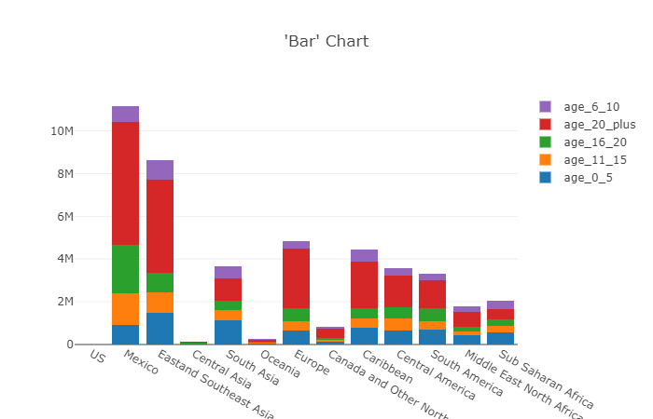
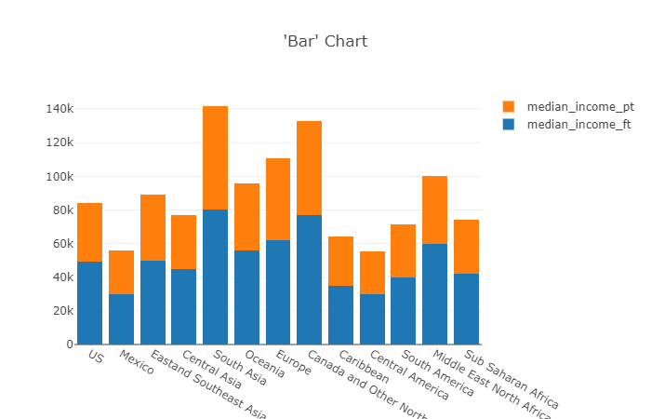
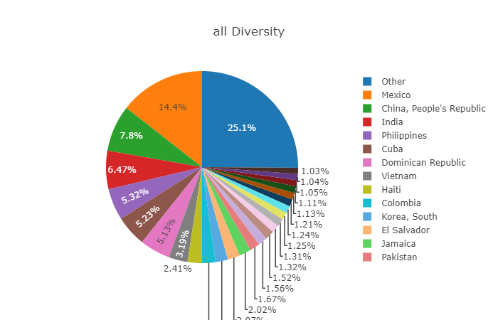
Visualizations
Notes:
1.5 min

Slide 7
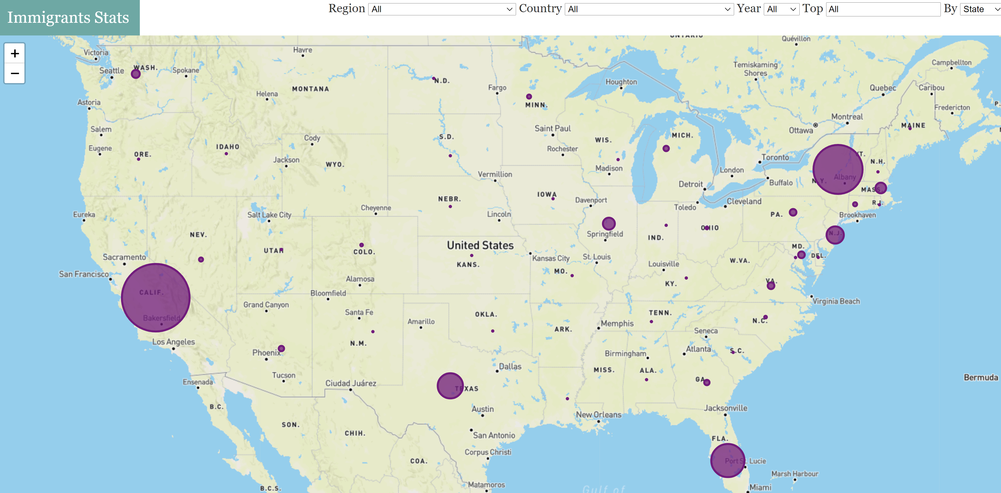
Visualizations

Slide 8
Demonstration (Max)
Here’s what we have available in the Group 6 Visualization Engine
Notes:
3 mins

Slide 9
Analysis (Max)
What do the visualizations tell us?
Notes:
2 min

Slide 10
Conclusions
Notes:
1 min

